Slide 1

Exploratory Data Analysis
Data Analyst:: Cross selling recommendation

Slide 2
Agenda
Task:
1. Business understanding
2. Data Understanding
3. Data Cleansing and Transformation
4. Exploratory data analysis
5. EDA Recommendation (ppt)

Slide 3
Problem Statement:
XYZ credit union in Latin America is performing very well in selling the Banking products (eg: Credit card, deposit account, retirement account, safe deposit box etc) but their existing customer is not not buying more than 1 product which means bank is not performing good in cross selling (Bank is not able to sell their other offerings to existing customer). XYZ Credit Union decided to approach ABC analytics to solve their problem

Slide 4
Business understanding
Cross selling involves selling complementary products to existing customers.It is one of the highest effective techniques in the marketing industry.It identifies products that satisfy additional,complimentary needs that are unfulfilled by the original item.Cross selling can alert users to products they didnot previously know you offered,furthur earning their as their confidence as the best retailer to satisfy a particular need.

Slide 5
Data Understanding
There are 2 files: Test and Train. Test file hasn't any info about products and we can’t use this file for analysis.
Let’s check the number of rows in train datasets, what type of variables are there and whether values are null (info in %).

Slide 6
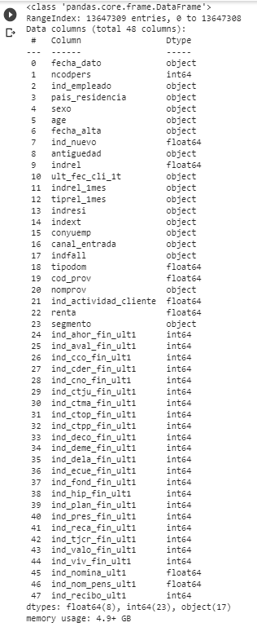
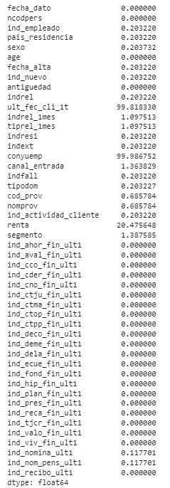

Slide 7
Train dataset contains info about customers and their products.
Train dataset contains 48 features and 13 647 309 rows. There are no duplicates.
Some of features was defined as object, but it is Numerical Variables: age, antiguedad.
Some features in opposite were defined as float64, but it is categorical features: ind_nuevo, indrel, tipodom, cod_prov, ind_actividad_cliente
In general:
Continuous Variables: 'age', 'antiguedad', 'renta'
Categorical Variables: others
There are some features with the same number of missing values, I expect those relate to the same rows. We delete rows with a lot of missing values (0.2% of data).
DESCRIBE DATA

Slide 8
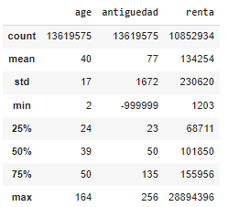

Slide 9
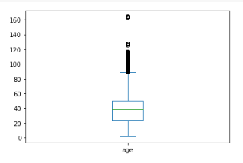
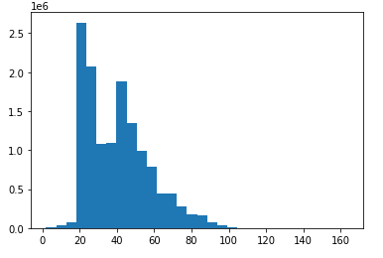
Outliers in numeric data:
The feature 'age' has some rows with customers who are older than 100 years and a few customers who are very young. We think there is a lot of incorrect data. We can see that customers who are older 20 and younger 90 are most. One of the ways to overcome outliers is to unite the youngest and most adult customers into groups.

Slide 10
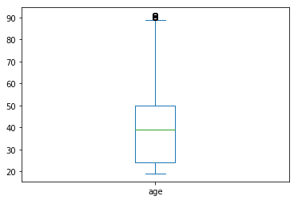
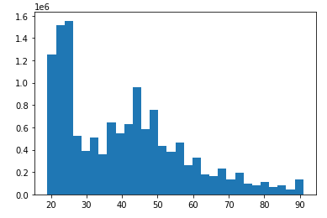
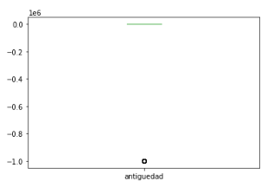
Graphs after corrections:
The feature 'antiguedad' (Customer seniority (in months)) contains 38 rows with value -99999. It makes the data very skewed. We should delete rows with this value, because it is an unknown value:

Slide 11
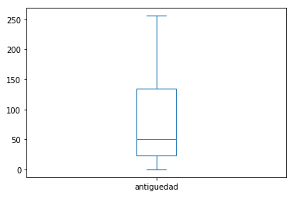
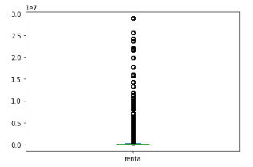
The box plot feature’s 'antiguedad' after deleting:
The feature Renta is also very shifted, because there is 18,9% data much more than 75% quartile.
Almost 19% of data are the outliers. And 20% of data is null. Delete these rows will be incorrect. It is necessary to carry out work on the replacement of zero values and emissions. For NA values it can be for example mean/median/mode/segmented approach etc.
For outliers it can be grouping.

Slide 12
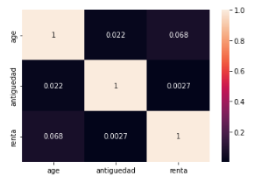
There is no correlation between numerical features:
categoricategorical:
ind_empleado - Employee index. No NA values, 99 % rows have the value N not employee.
pais_residencia - Customer's Country residence. No NA values. 118 unique values. 99 % rows have the value ES.
sexo - Customer's sex. A small number NA values (0.0005% or 70 rows). It is necessary to carry out work on the replacement of NA values (the most popular values for example).

Slide 13
fecha_alta - The date in which the customer became the first holder of a contract in the bank. No NA values.
ind_nuevo - New customer Index. 1 if the customer registered in the last 6 months. Data type float, should be changed to categorical. No NA values.
indrel - 1 (First/Primary), 99 (Primary customer during the month but not at the end of the month). No NA values. If you build an ML model, it could be better to change 99 on 0 because it is scaled for ML models.
ult_fec_cli_1t - Last date as primary customer (if he isn't at the end of the month) and conyuemp - Spouse index. (1 if the customer is spouse of an employee). have 99% null values. According to the instructions conyuemp feature should contain number 1 if the customer is spouse of an employee. In dataset the feature conyuemp contain (N, S, nan) values. I suppose that N=No, S = Si (Yes). The number of clients with value ‘S’ = 17. We can delete these features because they contain too small info for analysis.
indrel_1mes - Customer type at the beginning of the month and tiprel_1mes- Customer relation type at the beginning of the month. There are 0.89% NA values. It is necessary to carry out work on the replacement of NA values.

Slide 14
7)indresi - Residence index. No NA values. 99% of customers have the same residence country as the bank country.
8) indext - Foreigner index. No NA values. (S (Yes) or N (No) if the customer's birth country is different than the bank country) 0.95 % of rows have value N.
9) canal_entrada - channel used by the customer to join. 162 unique values. The most popular is KHE. 1.16% are NA values. We can replace the missing values with the most popular values in general or by region or something else.
10) indfall - Deceased index - 0.99 of rows have value N (not). No NA values.
11) tipodom - Address type. 1, primary address. No NA values.
12)cod_prov (Province code ) and nomprov (Province name) explain the same thing. I suppose delete feature cod_prov and change on categorical values feature nomprov. They have the same number of NA values - 0.48%.
13) ind_actividad_cliente - Activity index (1, active customer; 0, inactive customer). No NA values. There are 54% inactive customers.
14) segmento - segmentation: 01 - VIP, 02 - Individuals 03 - college graduated. 1.18% NA values. PARTICULARES customers are 58%, UNIVERSITARIO customers are 36%, TOP customers are 4%
15) Other features describe the product and customer's product availability.

Slide 15
Approaches to overcome problems like NA value, outlier etc:
NA values:
replacing with a mean value where there are not many missing values, this will not affect the result due to the small volume.
replacing the average value based on the data of another feature (Segmento-Renta).
Alternatively, you can set a constant value for NA-marked values. For example, you can put in a special string or numerical value
Outliers:
Grouping data (all clients with an age of less than 20 years, set the age of 19 years to those from 90 - 91 years)
Moving from numeric data to categorical data (renta)

Slide 16
Data_Cleansing_&_Transformation
link:
https://github.com/KseniyaLem/clean_data_group/blob/main/DATA_CLEANING_WEEK_9.ipynb

Slide 17
Exploratory data analysis
link:
https://github.com/pranav611/week-10-EDA-ON-CROSS-SELLING-RECOMMENSATIONS./blob/main/EDA_ON_CROSS_SELLING_RECOMMENSATIONS.ipynb

Slide 18
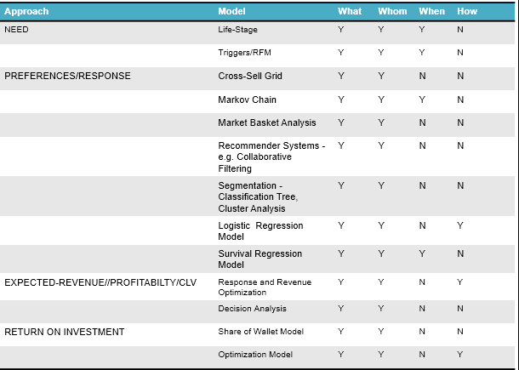
EDA recommendations and proposed model technique
The models provide answers to the following questions
What – choice of product
Whom – selection of customers
When – timing
How – contact strategy

Slide 19
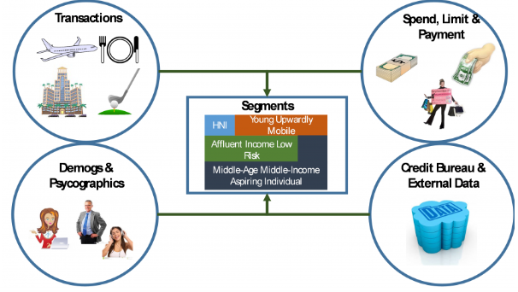
2. Segmentation: For customized one- to- one marketing programs as each segment may have different needs and preferences. The Response Model will be developed for the Segment “Affluent Income Low Risk”.

Slide 20
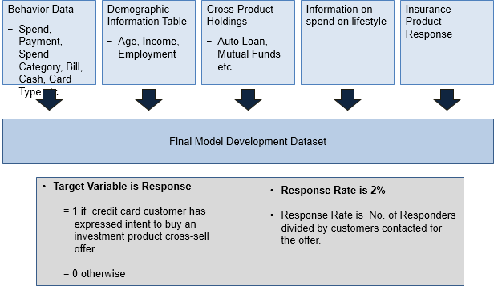
3.

Slide 21
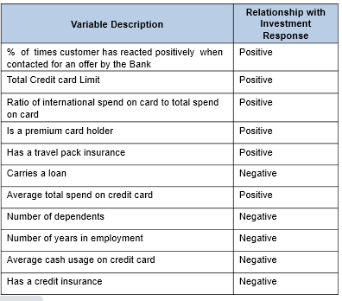
Response Model: The following table shows the variables description and relationship to cross-sell response / propensity in descending order of importance using Logistic Regression

Slide 22
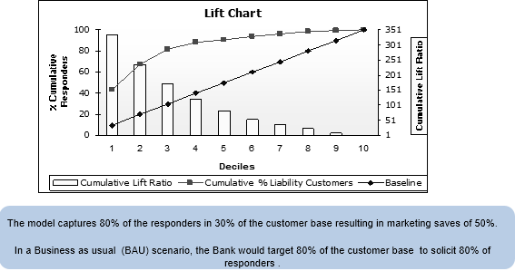

Slide 23
Thank You

